Slide 1
DESIGN AND MANUFACTURING OF ROTARY STORAGE SYSTEM

Slide 2
Problem :-
In industries, material handling and storing system is very time consuming and sometimes are hazardous to workers and organization.
Nowadays in industry, materials are kept in storeroom with stock and mix-up parts to each other which may cause damage.

Slide 3
Solution:-
So overcome this problem of material handling and storage in industries, we create new technology is rotary storage system which is applicable for material storage and also better management of organization for inventory.
This system have used to store raw material, assembly parts, finished parts, tools and equipment separately in system compartment.

Slide 4
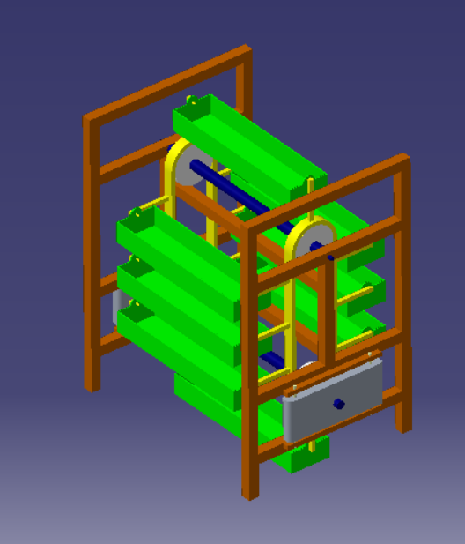

Slide 5
Methodology :-
1) Firstly we will design the boxes for different load carrying capacity.
2) Then we will design the chain and sprocket mechanism for the storage system.
3) According to the load carrying capacity of the container we select a motor of that load capacity.
4) We test the machine for different loads.

Slide 6
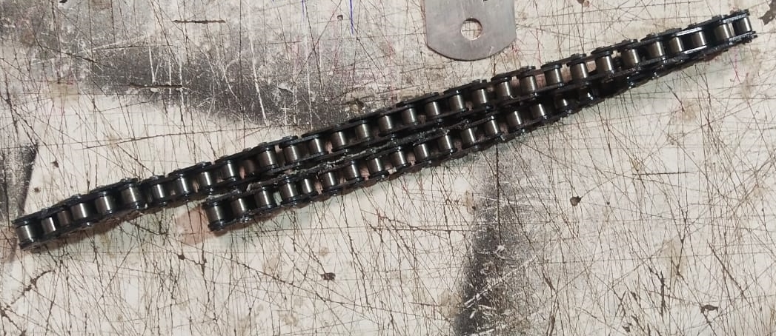
Parts of rotary storage system
Chain drive :- A chain can be defined as a series of links connected by pin
joints.
- chain drive is intermediate between belt and gear drives.
- Chain drives can be used for long as well as short center distances.
- They are particularly suitable for medium center distance, where gear drives will require additional idler gears.

Slide 7
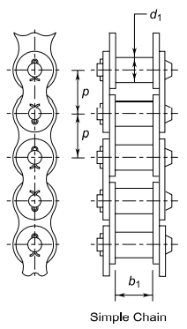
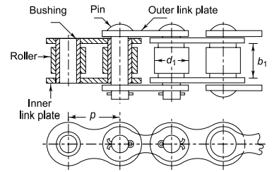
Roller chains :-
It consists of alternate links made of inner and outer link plates. A roller chain consists of following five parts:
Pin
Bushing
Roller
Inner link plate
Outer link plate

Slide 8
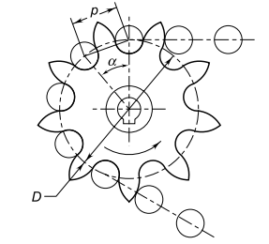
Sprocket :- The sprocket is a toothed wheel with a special profile for the
teeth.
D = pitch circle diameter of the sprocket
α = pitch angle

Slide 9
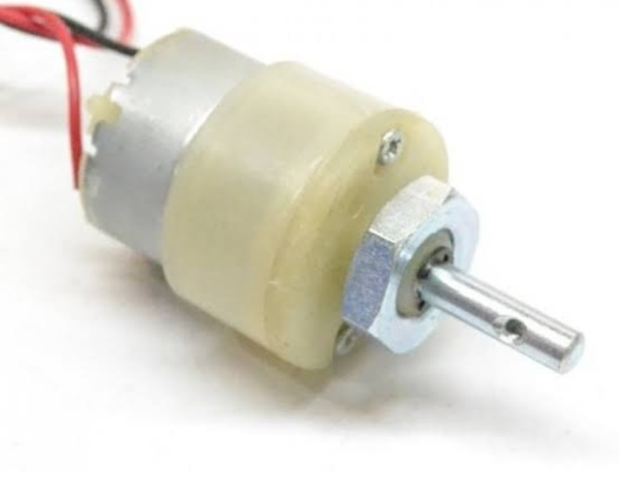
Shaft :- Shaft is used to transmit power from one point to another.
4. Motor :- DC motor is a rotary motor which can convert the direct current
into mechanical energy or convert mechanical energy into DC
power.
motor plate is used to fix the motor to drive the shaft.

Slide 10
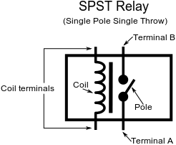
Automated parts
1) Relay :-

Slide 11
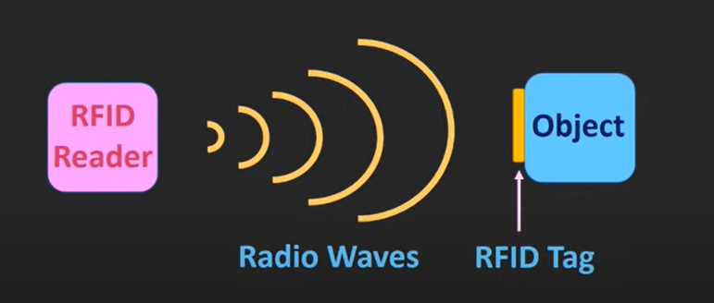
2) RFID :- RFID is a technology which is working on radio waves.
This technology is used for automatically identifying the object
or tracking the object.
RFID - Radio frequency identification.

Slide 12
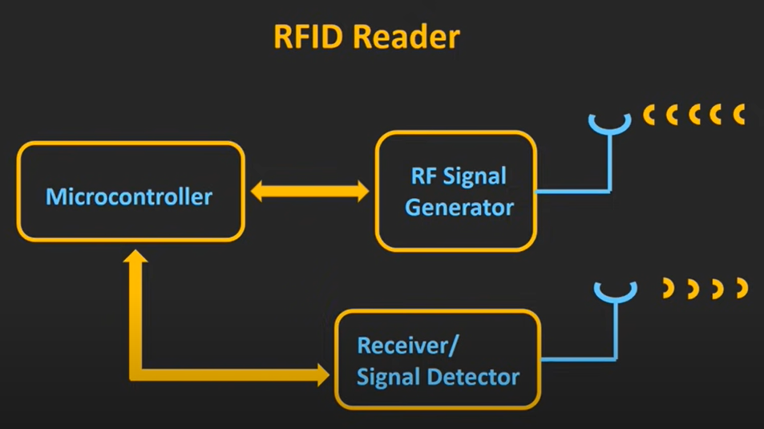

Slide 13
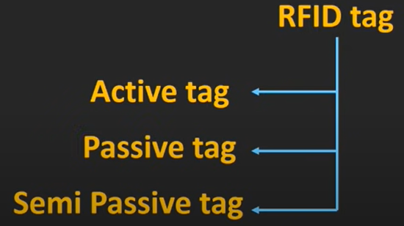
RFID tags :- RFID tags are getting attached to the object which we want to track.
RFID reader continuously sending the radio waves when object with RFID
tag is in the range of reader then this RFID tag transmits its feedback
signal back to reader.
Most of the tags which are being used today are passive tags.
Because these passive tags are quiet cheaper than active and semi passive tags.
These tags don’t have their own power supply so these tags relay on radio signal coming from reader.

Slide 14
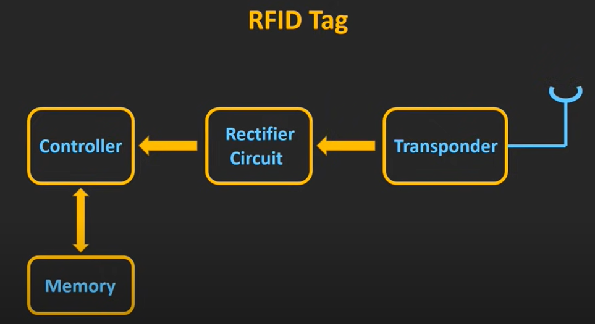

Slide 15
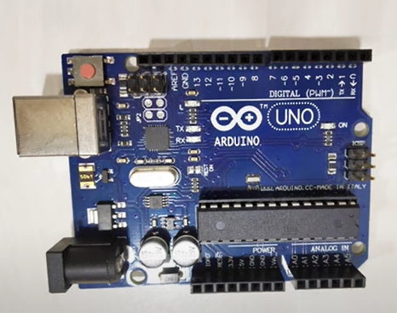
Arduino Uno :- Arduino is an open-source electronics platform
based on easy to use hardware and software.
You can tell your board what to do by sending a
set of instructions to microcontrollers on the
board.

Slide 16
Objective
To save time
Increase productivity

Slide 17
Advantages :-
System is easy to operate
Time is saved
Space required is less

Slide 18
Disadvantages :-
High initial cost
Maintenance is required

Slide 19
Cost :-
No. | Component Name | Cost | Quantity | Total
1 | Chain and Sprocket | 600 | 2 | 1200
2 | Lead Screw | 500 | 2 | 1000
3 | Frame | 3000 | 1 | 3000
4 | Arduino UNO | 500 | 1 | 500
5 | EM 18 Module | 800 | 1 | 800
6 | L293D | 200 | 1 | 200
7 | Keypad | 100 | 1 | 100
8 | RFID Card | 20 | 8 | 200
9 | DC Motor | 180 | 1 | 180
10 | Connecting Pipe | 210 | 1 | 210

Slide 20
Group details :-
Member 1 :- Saurabh Sanjay Kshirsagar
Roll no. :- 8014 (Mech A)
Member 2 :- Akshay Nivrutti Nimbole
Roll no. :- 8039 (Mech A)

Slide 21
THANK YOU

